Slide 1
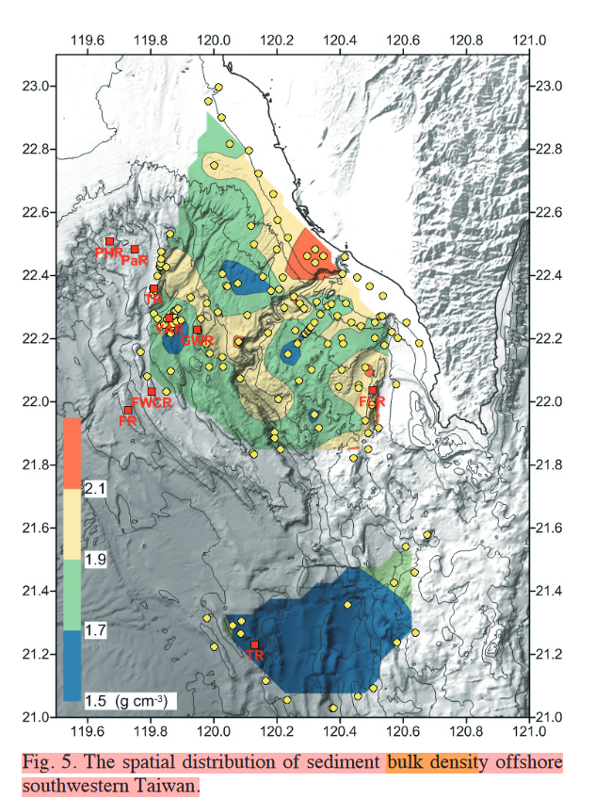
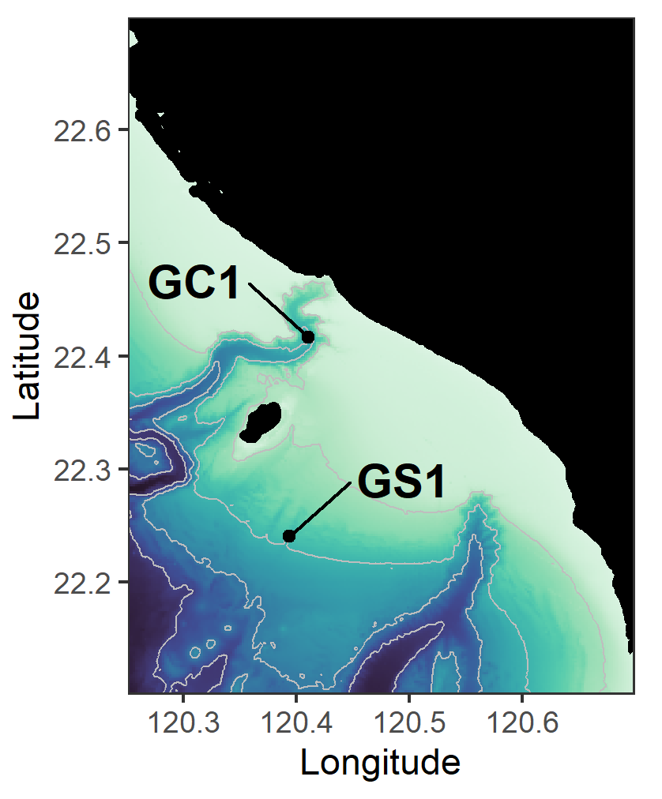
Bulk density
GC1: 120.41°E, 22.41°N
-> 2.1 (g/cm3)
GS1: 120.40°E, 22.23°N
-> 1.8 (g/cm3)

Slide 2
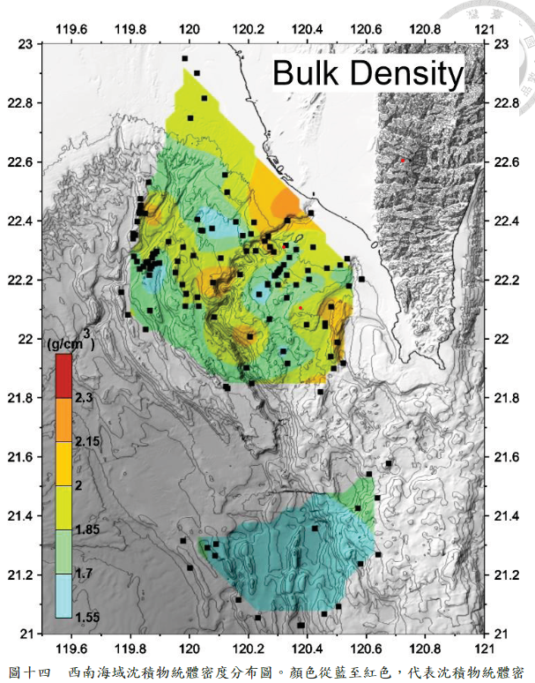

Slide 3
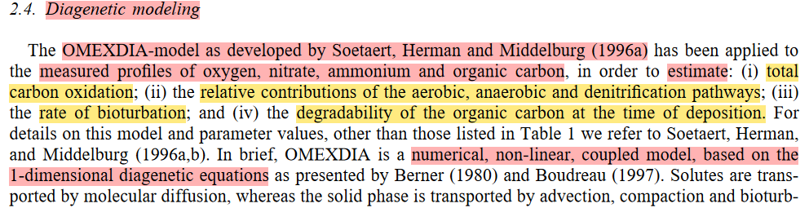
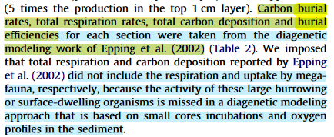
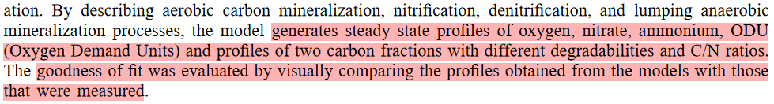
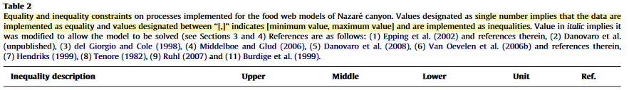
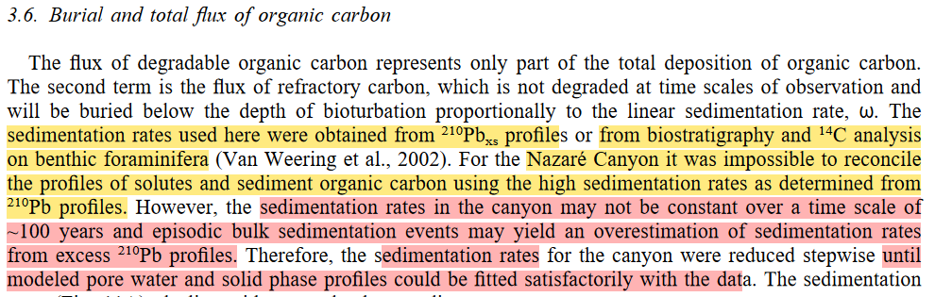
In Epping et al. (2002): model estimate BE
Burial efficiency (BE)
In van Oevelen et al. (2011)

Slide 4
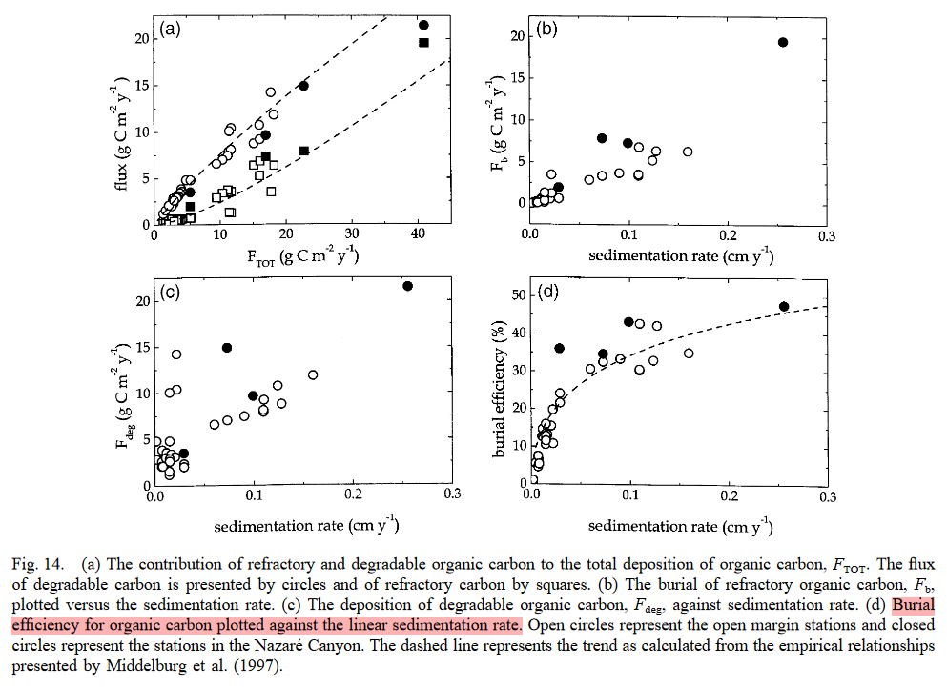
The carbon burial efficiency, calculated from (burial rate/total organic carbon flux)∗100%, plotted versus sedimentation rate yields a hyperbolic relation (Fig. 14D)

Slide 5
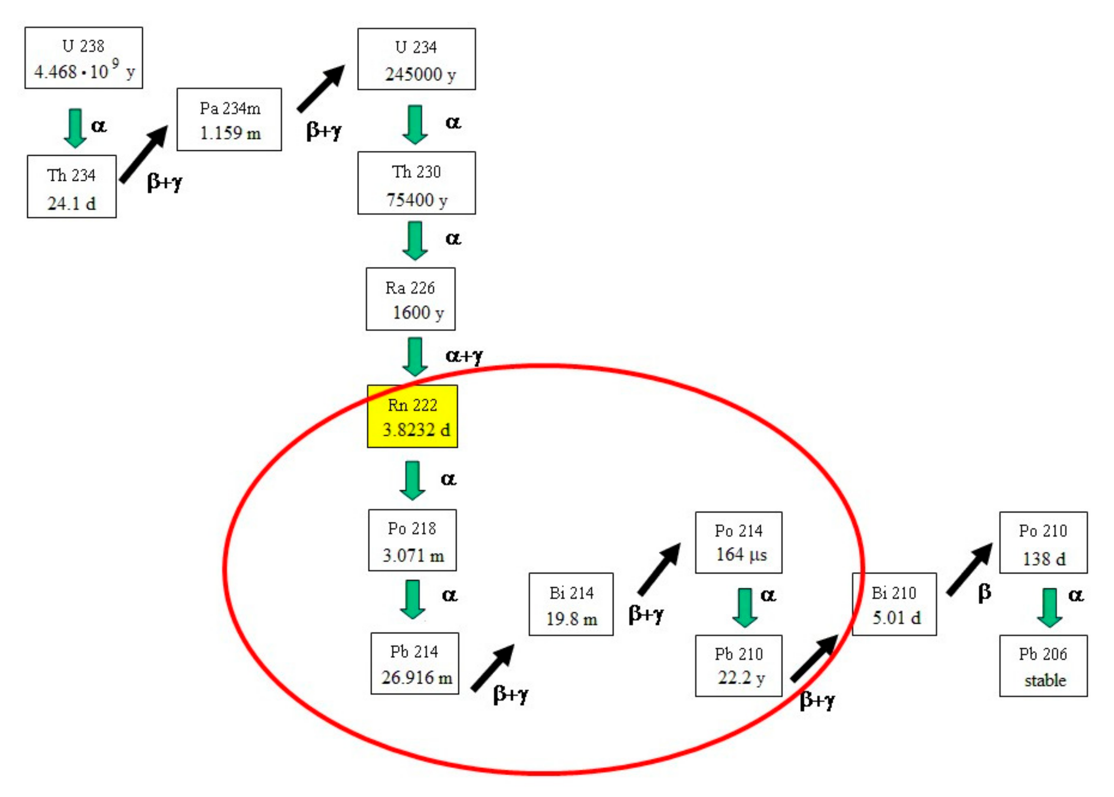
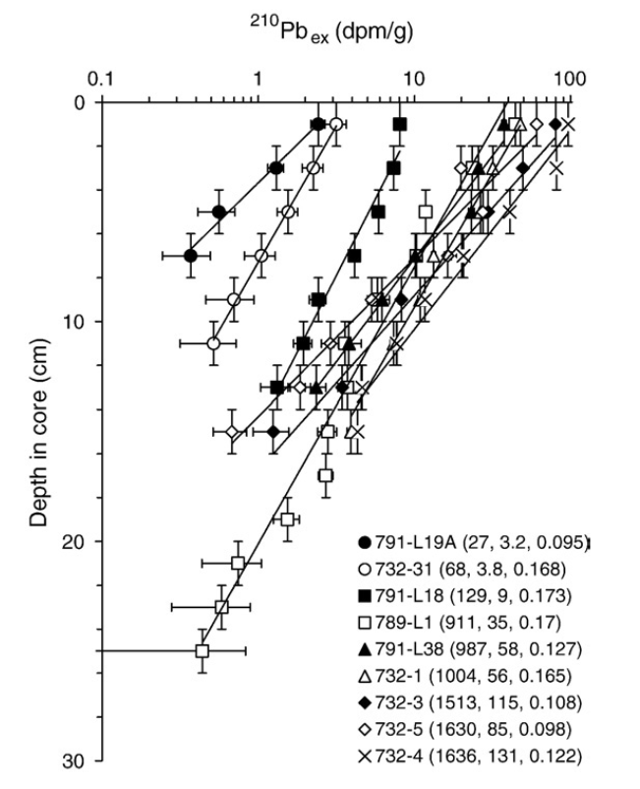
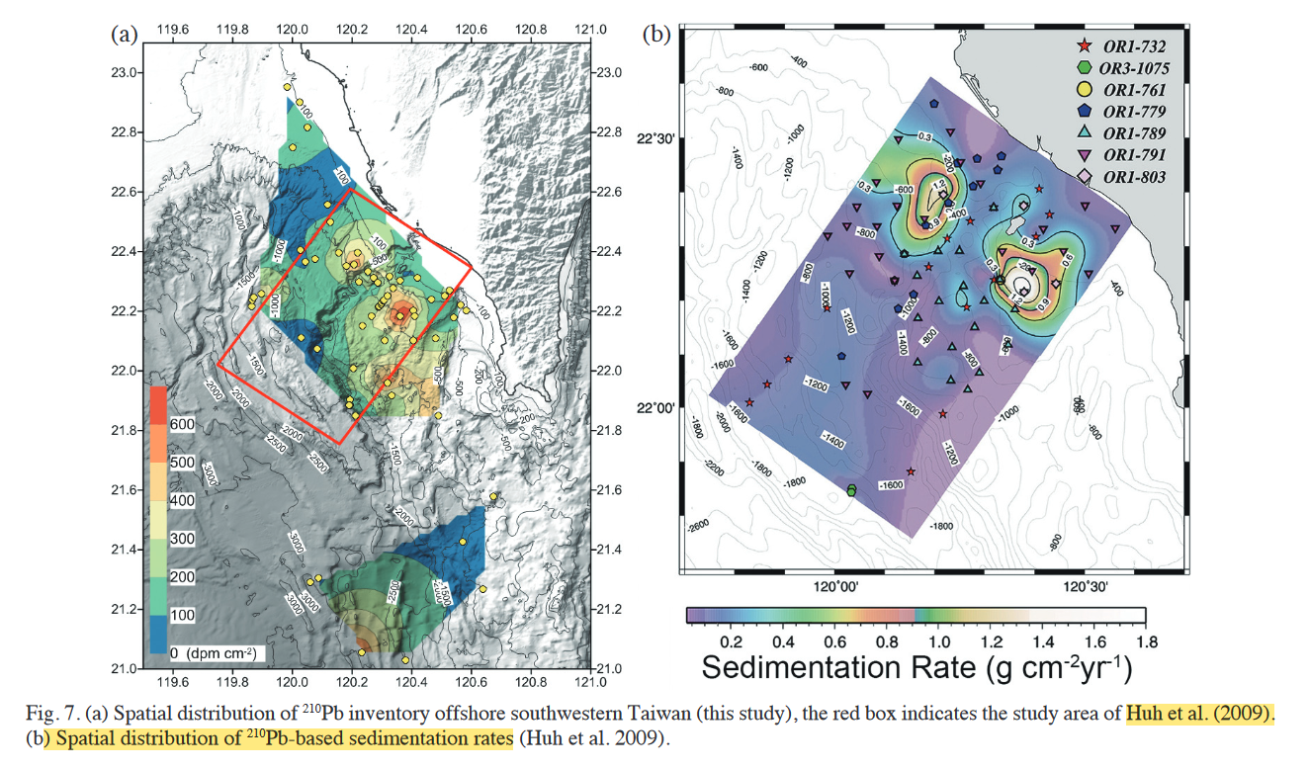
BE data in GPSC
burial rate= sedimentation rate
210Pb most commonly used chronometer for determining modern sedimentation rates in continental margin environments
210Pbex)z = 210Pbex)0 exp(− λ / S)
210Pbex)0: excess 210Pb at the sediment–water interface
210Pbex)z: excess 210Pb at depth Z
λ: decay constant of 210Pb
S: sedimentation rate
214Pb: supported 210Pb
unsupported 210Pb (excess 210Pb): 210Pbex = 210Pb − 214Pb)
From the slope of the regression line (− λ / S) fitting the depth trend of 210Pbex on a semi-log plot
ln 210Pbex v.s. apparent depth(cm) or cumulative mass(g cm⁻²)
→S (linear sedimentation rate(cm yr⁻ ¹) or mass accumulation rate in (g cm⁻² yr⁻¹)

Slide 6
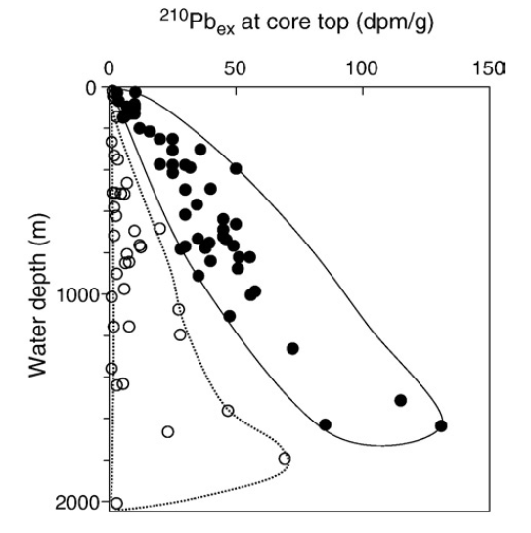
In theory, specific activities of excess 210Pb controlled by
Particle size
residence time of particles in water column
In general, sizes of sediment particles decrease, their residence times in seawater increase, with distance offshore and resulting greater water depths.
→ expect higher excess 210Pb activities in fine sediments freshly deposited in deep waters under steady-state conditions.
→ Any deviations from this general rule: non-steady state conditions.
solid circles: open shelf and slope
open circles: canyon floor or walls showing non-steady-state 210Pbex profiles.
The data imply that, on 210Pb timescale (~ 100 years), the KPSC is not a steady setting for 210Pb scavenging and sediment accumulation

Slide 7
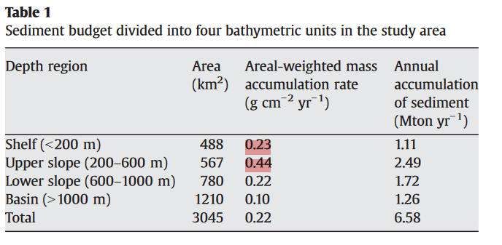
GC1-> 0.3 (g/cm2/yr)
GS1-> 0.7 (g/cm2/yr)
-> (*our TOC %再換算成mgC/m2/d) / POC flux (mgC/m2/d) = %, 代表BE的下限
In Huh et al. (2009)
The calculated budget for the shelf–slope–canyon system can only account for 13–18% of the KPR's annual sediment load, which is reported to be from 36 Mton/yr (Water Resources Bureau, 1998; Milliman and Kao, 2005)to 49 Mton/yr (Dadson et al., 2003). The remaining majority (82–87%) of the river's sediment load may be exported out of the study area by gravity flows through the KPSC.
Export

Slide 8
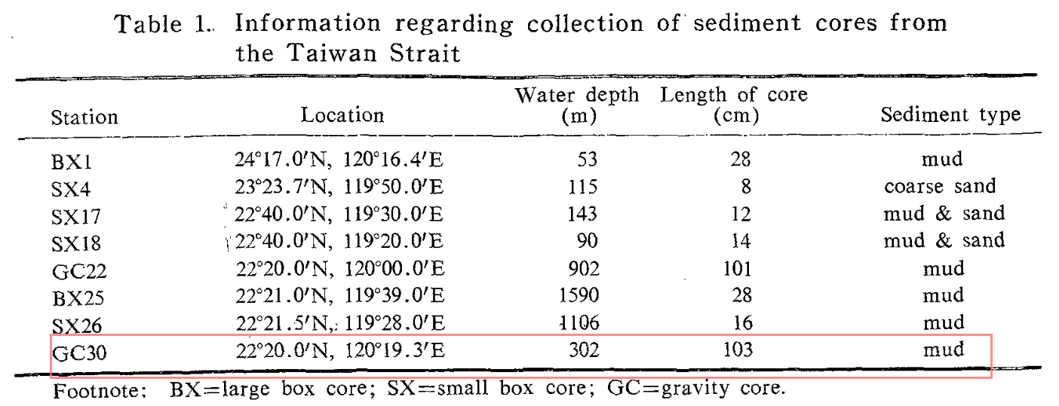
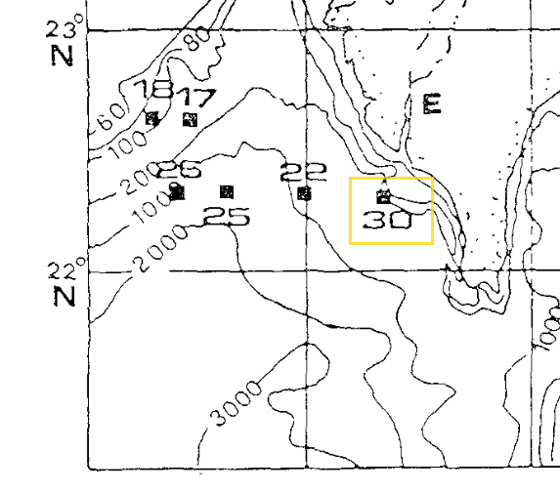
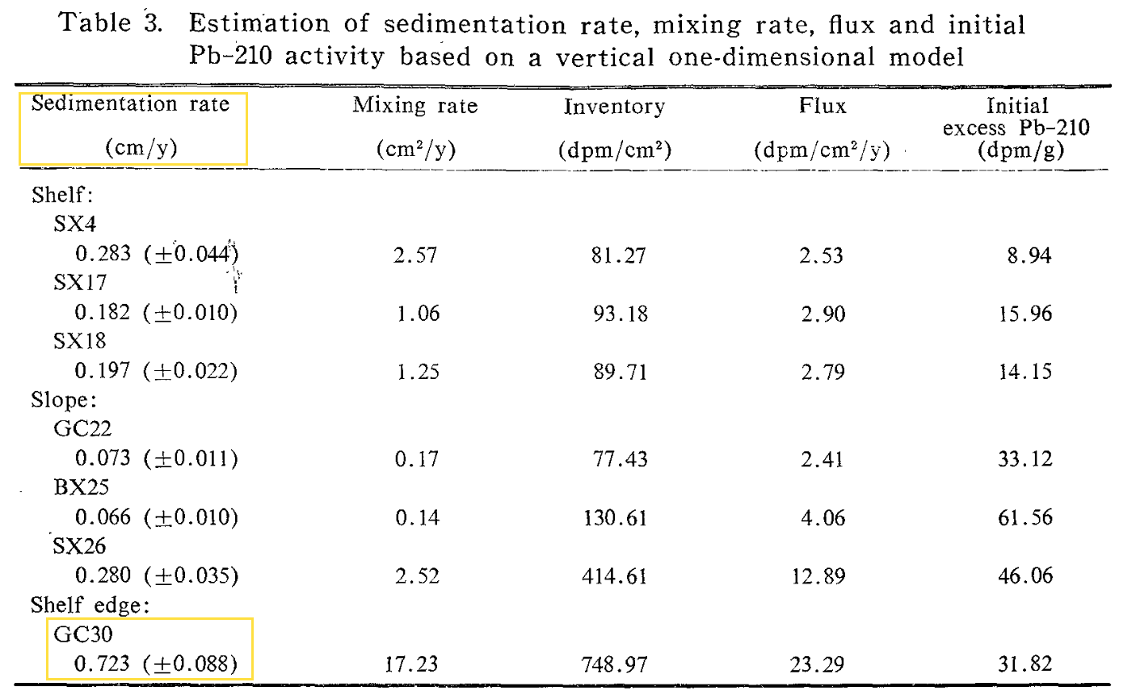
GC1: 120.41°E, 22.41°N / GS1: 120.40°E, 22.23°N
Tsai and Chung(1989)
Rates obtained by other methods have been converted from cm/ka to mg/cm2/yr by using density

Slide 9
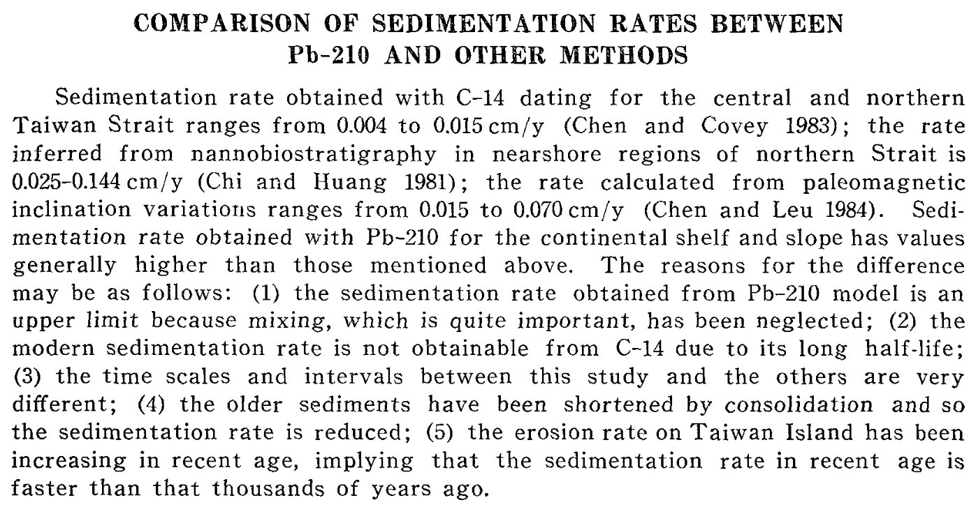

Slide 10
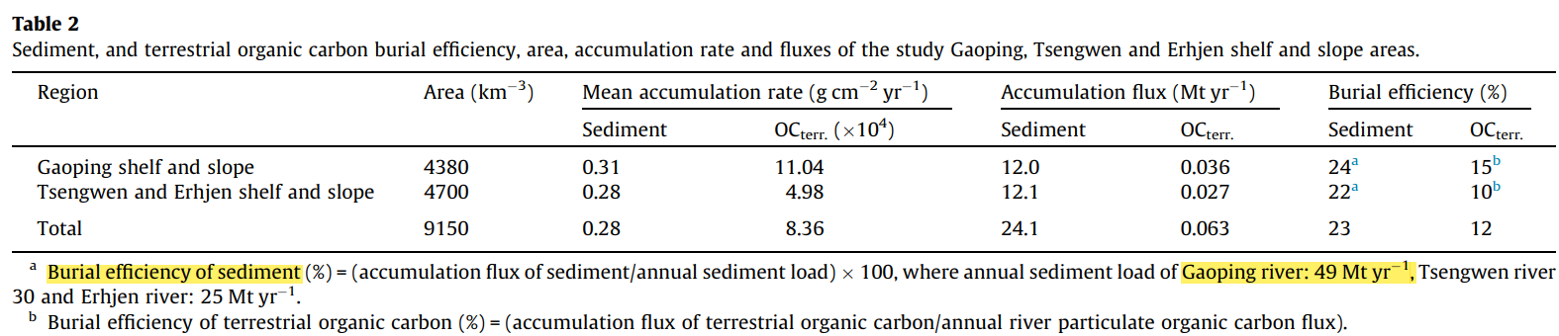
Hsu et al. (2014)
BE的上限
Kao et al. (2014)
provide a conservative estimate of terrestrial OC burial efficiency, we suggest < 30 % loss (i.e. preservation efficiency > 70 %) has occurred in these deposits.
To assess the fate of terrestrial OC delivered to the ocean by hyperpycnal discharges -> a sediment trap mooring was deployed at 608 m water depth, 42 m above the seafloor, in the submarine Gaoping Canyon
Conical sediment traps: conservative estimates of accumulation rate due to potential re-suspension of sediment in the funnel (Buesseler et al., 2007). Here we do not rely on accumulation rate data, but note that hydrodynamic sorting may result in a lower percentage of smaller, more buoyant particles present in the trap than the sediment plume during high current velocities.
To assess longer-term preservation, a box core was collected at station K1 (160 m water depth), located at the thalweg of the Gaoping Canyon
The sediments are thought to represent deposits associated with hyperpycnal river discharge during Typhoon
Together, these marine sediments allow us to assess the transfer and deposition of terrestrial materials by river hyperpycnal flows

Slide 11
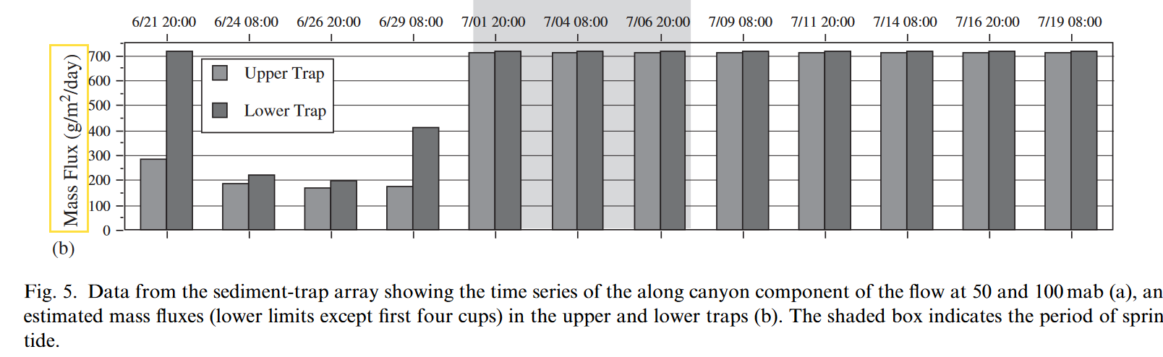
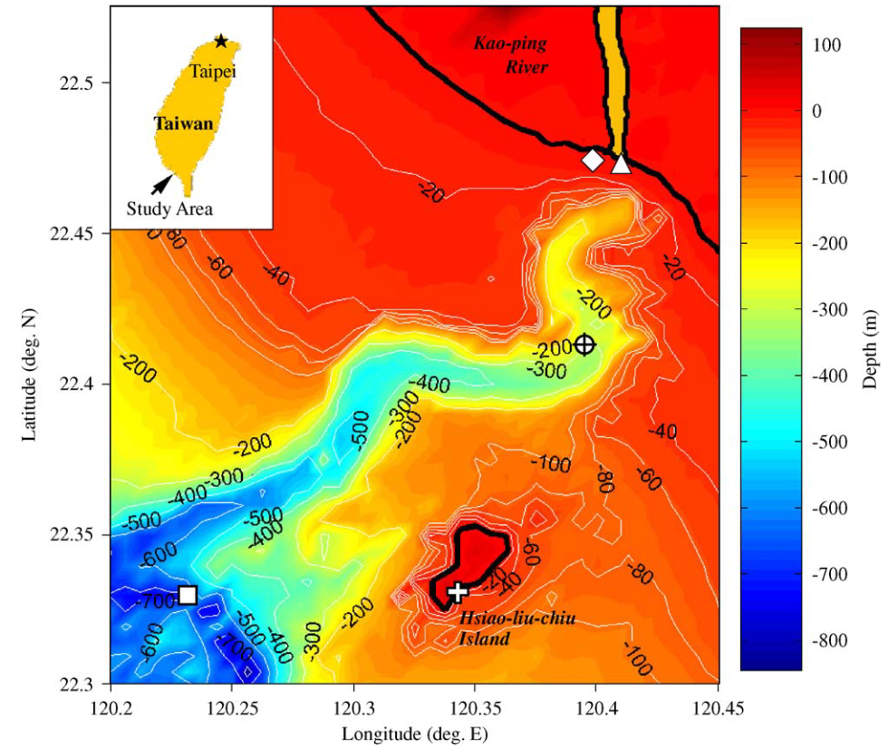
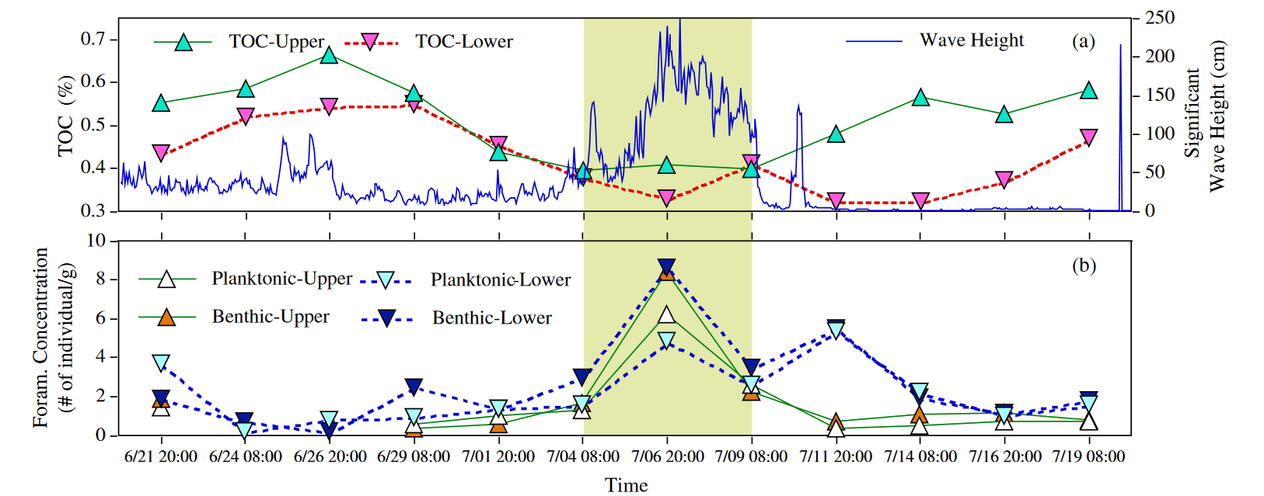
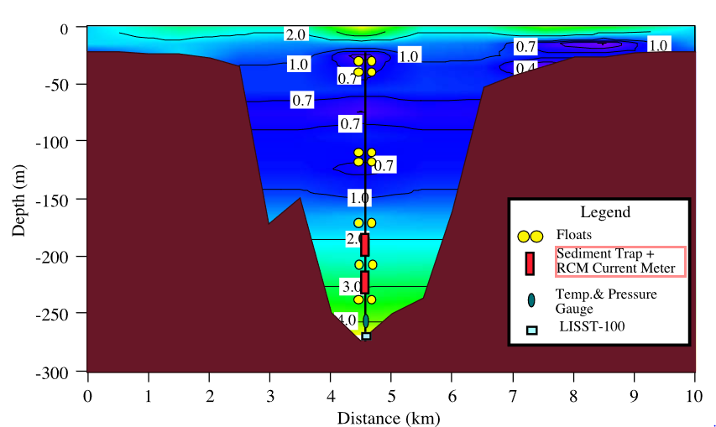
POC flux in GPSC
Liu et al. (2006): 200- 700 g/ m2/ d
TOC content (c.a. 0.4-0.6 %)
-> POC flux would be 800 to 4200 mg C/ m2/ d
trap
186m
54 mab

Slide 12
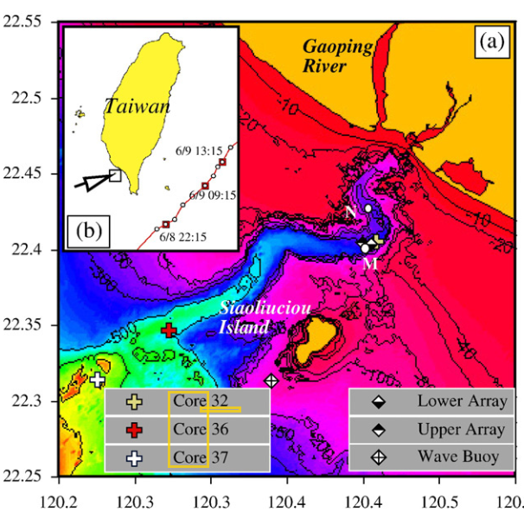
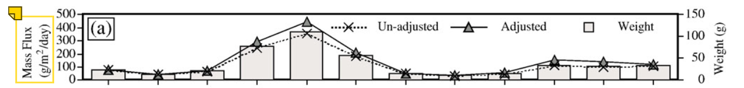
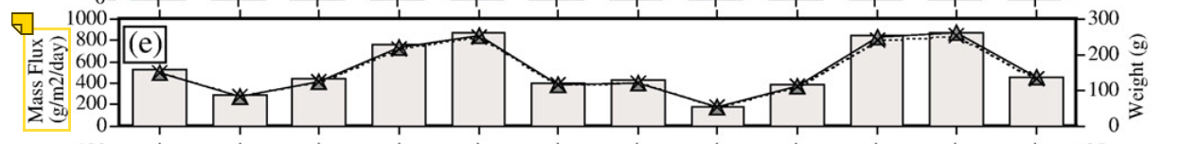
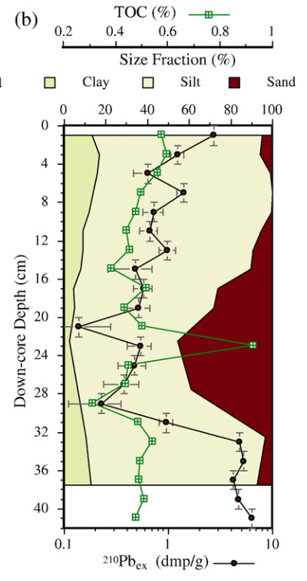
Trap:
Fluxes at the deeper part of the canyon: 2- 7 times > the upper rim of the canyon.
The difference in particle fluxes suggests that suspended particles in the deeper part of the canyon cannot all come from downward settling, and lateral transport is important in deeper part of the canyon.
POC flux in GPSC
Liu et al. (2009)
upper
Lower: 200-800 g/m2/day
Boxcore:
OR-III 732
Core #32
TOC content (c.a. 0.4-0.6 %) -> POC flux would be 800 to 4800 mg C/ m2/ d

Slide 13
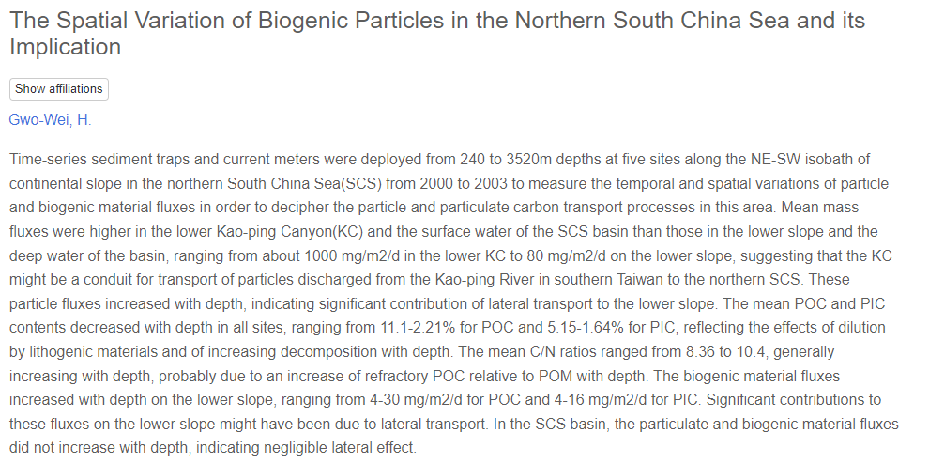
POC flux in GS

Slide 14
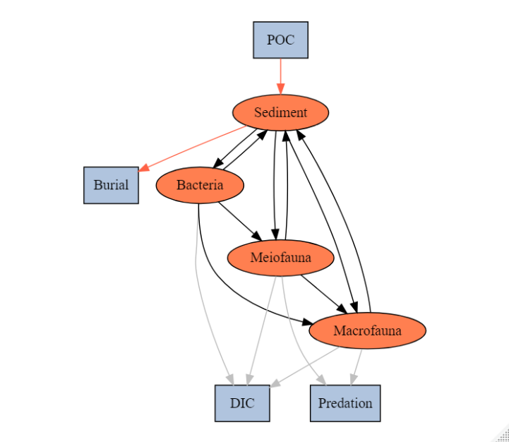

Original structure
From trap data
Revised structure
Estimated export %
Export
Sedimentation rate
################################ EXTERNALS
! Definition of the compartments that are part of
! the world external to the food web.
! No mass balances for these compartments are defined in the LIM
POC_W
EXP_S
BUR
EXP
DIC_W
EXP_B
################################ END EXTERNALS

Slide 15
SYM | MEANING
POC->SED | Organic matter derived from the water column
SED->BUR | Sediment burial
SED->EXP | Sediment export
SED->BAC | Bacteria feed on detritus OC
BAC->SED | Bacteria feces deposit on sediment
SED->MEI | Meiofauna feed on detritus OC
MEI->SED | Meiofauna feces deposit on sediment
SED->MAC | Macrofauna feed on detritus OC
MAC->SED | Macrofauna feces deposit on sediment
BAC->MEI | Meiofauna feed on bacteria
BAC->MAC | Macrofauna feed on bacteria
MEI->MAC | Macrofauna feed on meiofauna
MEI->EXP_B | Meiofauna predated by other benthopelagic/pelagic predators
MAC->EXP_B | Macrofauna predated by other benthopelagic/pelagic predators
BAC->DIC | Bacteria respiration
MEI->DIC | Meiofauna respiration
MAC->DIC | Macrofauna respiration
SYM | MEANING
POC->SED | Organic matter derived from the water column
SED->EXP_S | Sediment export(e.g. downslope, burial…)
SED->BAC | Bacteria feed on detritus OC
BAC->SED | Bacteria feces deposit on sediment
SED->MEI | Meiofauna feed on detritus OC
MEI->SED | Meiofauna feces deposit on sediment
SED->MAC | Macrofauna feed on detritus OC
MAC->SED | Macrofauna feces deposit on sediment
BAC->MEI | Meiofauna feed on bacteria
BAC->MAC | Macrofauna feed on bacteria
MEI->MAC | Macrofauna feed on meiofauna
MEI->EXP_B | Meiofauna predated by other benthopelagic/pelagic predators
MAC->EXP_B | Macrofauna predated by other benthopelagic/pelagic predators
BAC->DIC | Bacteria respiration
MEI->DIC | Meiofauna respiration
MAC->DIC | Macrofauna respiration

Slide 16
################################ PARAMETER
!-- Stocks
SEDSS = revised {mgC/m2}
BACSS = 65.31 {mgC/m2}
MEISS = 1.49 {mgC/m2}
MACSS = 3.65 {mgC/m2}
!-- Constraints
!burial efficiency
minSEDbe = 0.24 {fraction}
maxSEDbe = 1 {fraction}
!Burial rate
minBR = revised {fraction}
maxBR =0.7 {fraction}
!export rate
minER =0.0 {fraction}
maxER =0.87 {fraction}
!POCflux
minPOC =800 {mgC/m2/d}
maxPOC =4800 {mgC/m2/d}
################################ CONSTRAINT
!-- SED
SED -> EXP_S = [minSEDbe,maxSEDbe]* POC_W -> SED !SED burial rate
POC_W->SED= [minPOC,maxPOC] !POC flux
SED->BUR = [minBR,maxBR] * POC_W->SED !Burial
SED->EXP = [minER,maxER] * POC_W->SED !Export
Huh et al. (2009)
Kao et al. (2014)
Huh et al. (2009)
Liu et al. (2006)
Liu et al. (2009)

Slide 17
Seasonal model
Cruises with complete data
GC1: OR1_1114(su),OR1_1126(au),OR1_1128(sp) : take Bac data from OR1_1190(SP)
OR1_1190(sp) : take Meio data from OR1_1128(sp)
GS1: OR1_1114(su),OR1_1126(au) : take Bac data from OR1_1190(SP)
OR1_1190(SP) :take Meio data from OR1_1132(sp)
-> 各做一個model
20220922meeting
先處理須計算的數字
Seasonal model 先不用處理
如何解釋sedimentation rate 觀測值為burial rate 的下限 但實際跑出來的值更高:
因為poc flux 測量時間短+變動量大，但sedimentation rate 測量時間長(但視為平均) 相除後最小的值作為下限
Model 結果值高=合理

Slide 18
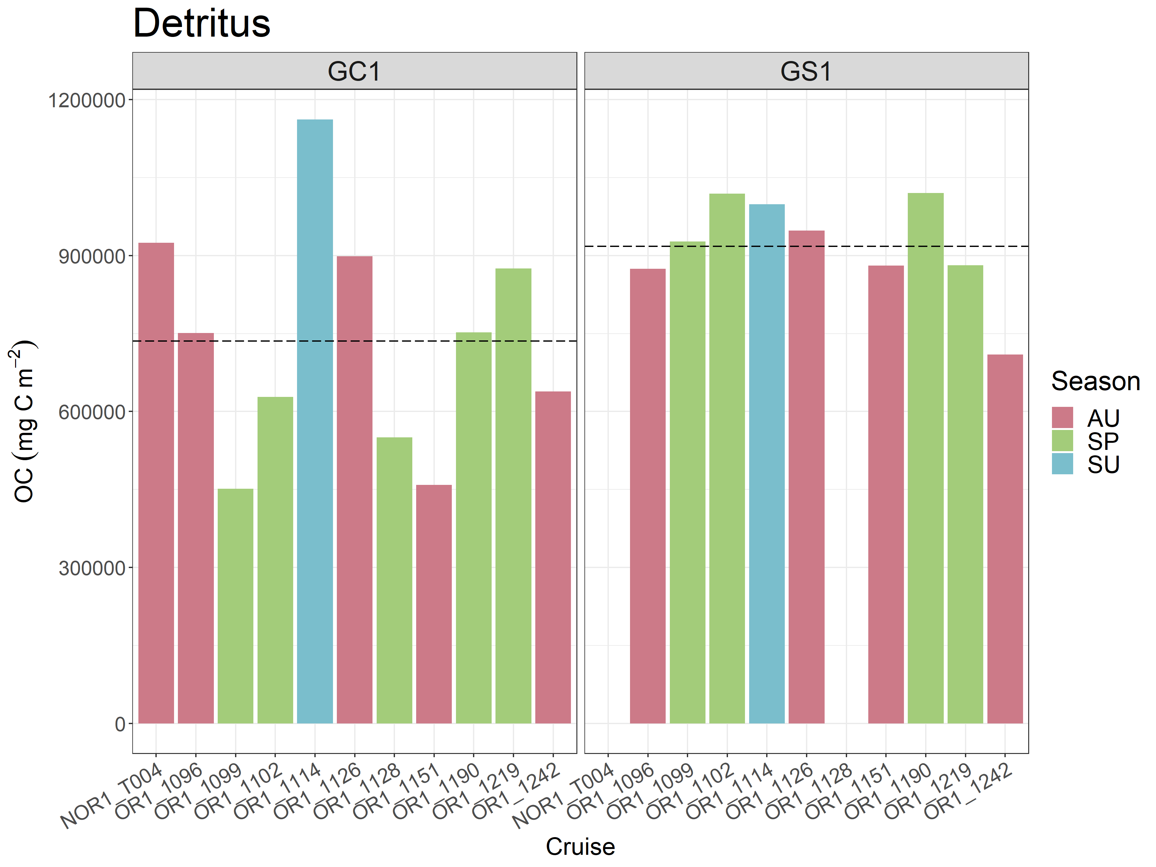
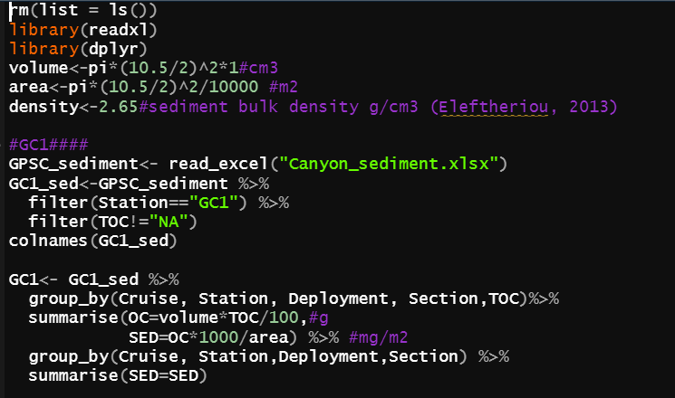
GC1: Variant, higher than GS1 during summer
SED OC
Forgot to time the density in my thesis…
Revision
Density #sediment bulk density g/cm3 (Su, 2018)
GC1density<-2.1
GS1density<-1.8
Station | SED OC stock (mg C/ m2)
GC1 | 735,566.93
GS1 | 917,914.2
Close to other canyons
Lower than average during spring
Correspond to dry season (winter)
Higher than upper continental slope in the Mississippi Canyon

Slide 19
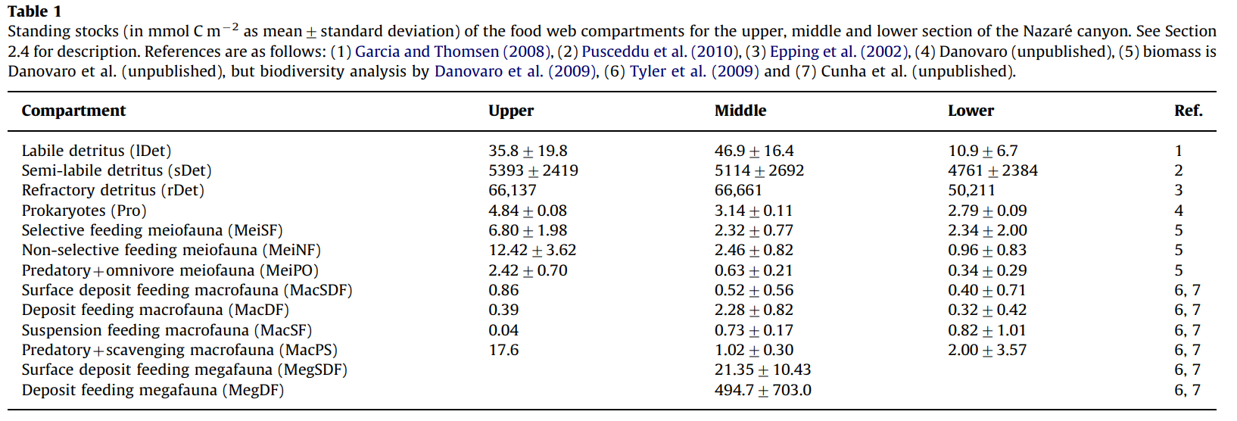
Comparison: Data from van Oevelen et al.(2011) in Nazare canyon
1mol C =12g C
mg C/m2
429.6
64716
793644
58.08
81.6
149.04
29.04
10.32
4.68
0.48
211.2
Compartment | Standing stock (mgC m⁻²)
Detritus | 858,789.6
Bacteria | 58.08
Meiofauna | 259.68
Macrofauna | 226.68

Slide 20
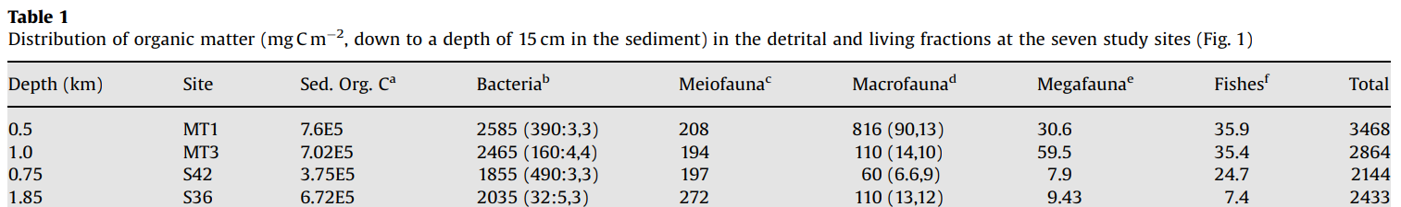
Comparison: Data from Rowe et al. (2008) in Gulf of Mexico
MT1: Mississippi canyon head
MT3: upper continental slope in the Mississippi Canyon
S36 : deep continental slope in the DeSoto Canyon
MT1
MT3
Compartment | Standing stock (mgC m⁻²)
Detritus | 760000
Bacteria | 2585
Meiofauna | 208
Macrofauna | 816
Compartment | Standing stock (mgC m⁻²)
Detritus | 702000
Bacteria | 2465
Meiofauna | 194
Macrofauna | 110

Slide 21
BE data in GPSC
1. calculate the burial rate
# In Huh et al. (2009)
GC1_br<- 0.3 (g/cm2/yr)
GS1_br<- 0.7 (g/cm2/yr)
#br(g/cm2/yr)*1000/0.01/0.01/365*TOC(%)/100=(mgC/m2/d)
GC1_TOC<-0.39
GS1_TOC<-0.53
GC1_br<-0.3*1000/0.01/0.01/365*GC1_TOC/100 #=32.08(mgC/m2/d)
GS1_br<-0.7*1000/0.01/0.01/365*GS1_TOC/100 #=100.92(mgC/m2/d)
#2. POC flux
#in Liu et al. (2006): 200- 700 g/ m2/ d
#in Liu et al. (2009): 200- 800 g/ m2/ d
#TOC content (0.4-0.6 %)
GC1_POCmin<-200*1000*0.4/100 #=800
GC1_POCmax<-800*1000*0.6/100 #=4800
#3. min burial efficiency=
burial rate (mgC/m2/d) / poc flux (mgC/m2/d)
GC1_br2/GC1_POCmin #=0.0842
GC1_br2/GC1_POCmax #=0.0140
GS1_br/GC1_POCmin #=0.1261
GS1_br/GC1_POCmax #=0.0210
Use the higher value to shorten the constraint of BE (max=0.7)
Our data
#In Hsu et al. (2014)
#GS1_br<-0.31(g/cm2/yr)< 0.7 #(g/cm2/yr)
#In Tsai and Chung(1989)
#GC1_br<-0.723(cm/yr)
#br(cm/yr)*density(g/cm3)*1000/0.01/0.01/365*TOC(%)/100=(mgC/m2/d)
GC1density <-2.1
GC1_br2<-0.3*2.1*1000/0.01/0.01/365*GC1_TOC/100 #=67.36
#GC1_br2 > GC1_br -> use this data
Su et al. (2018)

Slide 22
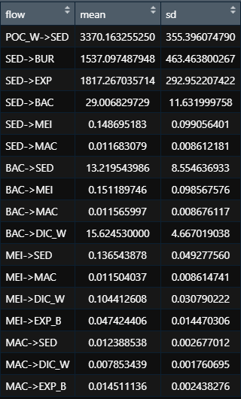
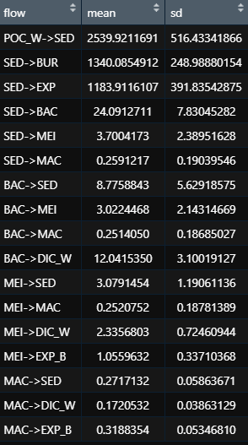
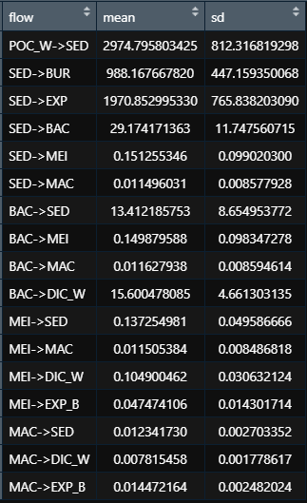
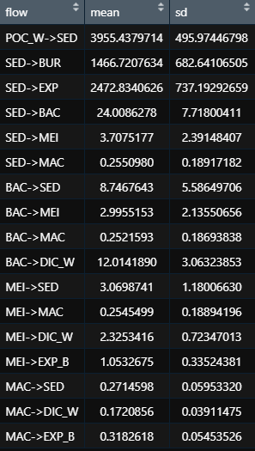
LIM Results
Mean coverage 92.09
Mean coverage 92.38
45.6%
52.8%
33.2%
37.1%
53.9%
46.6%
66.3%
62.5%
GC1_10000
GS1_10000
GC1_25000
GS1_25000
Mean coverage 87.80
Mean coverage 87.98
Took 1 hr to run

Slide 23
More constraints on SED flows
!Burial rate
minBR =0.0842 (GC1)/ 0.1261(GS1) {fraction}
maxBR =0.7 {fraction}
Close
1. Limit POC
Set GC1_POC<-200*1000*0.4/100 #=800
4800 during spring tide/typhoon
To see the difference between GC1 and GS1
Drawback: not efficiently constrain BR and ER
!export rate
minER =0.0 {fraction}
maxER =0.87 {fraction}
2. Burial efficiency
GC1_POC<-200*1000*0.4/100 #=800
Use minimum to maximum BE from the calculation
!Burial rate
minBR =0.0140 (GC1)/0.0210(GS1) {fraction}
maxBR = 0.0842 (GC1)/ 0.1261(GS1) {fraction}
!export rate
minER =0.0 {fraction}
maxER =0.87 {fraction}

Slide 24
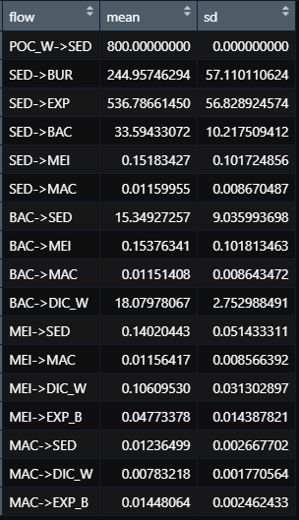
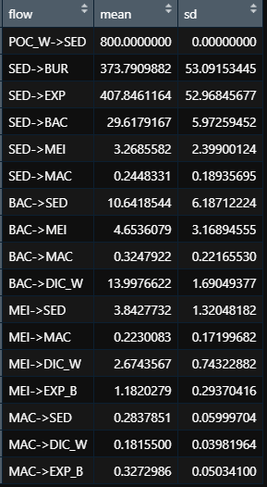
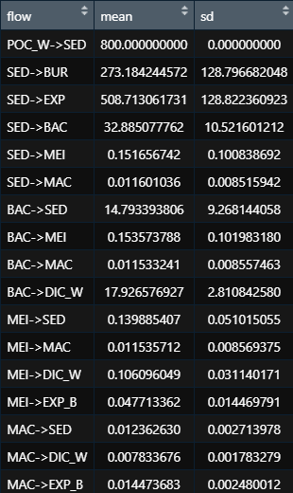
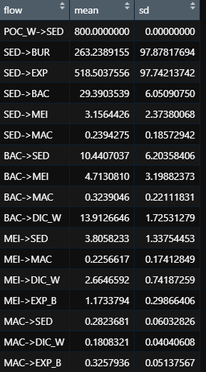
1. Limit POC
Set GC1_POC<-200*1000*0.4/100 #=800
To see difference between GC1 and GS1
30.6%
46.7%
34.1%
32.8%
67.1%
50.9%
63.5%
64.8%
GC1_25000
GS1_25000
GC1_10000
GS1_10000
Mean coverage 87.88
Mean coverage 86.46
Mean coverage 94.03
Mean coverage 93.05

Slide 25
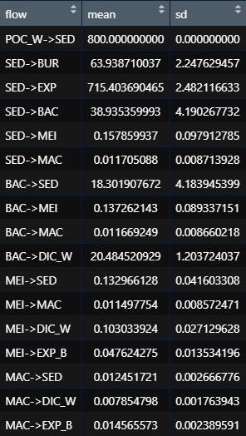
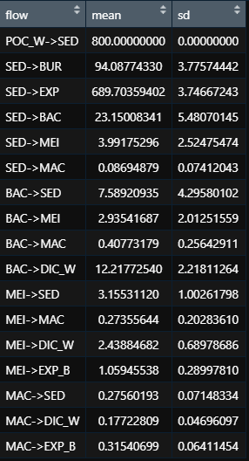
2. Burial efficiency
GC1_POC<-200*1000*0.4/100 #=800
Use minimum to maximum BE from the calculation
GC1: lsei error
When POC input=800 and max ER=87%, the calculated burial efficiency + biological consumption are too low to balance the system
-> raise max ER to 90%
GS1: successfully run
7.99%
11.8%
89.4%
86.2%
Q: is it reasonable to set POC flux at 800 while we still use BE which was calculated from 800-4800 of POC flux?
GC1_10000
GS1_10000
Mean coverage 84.40
Mean coverage 87.88

Slide 26
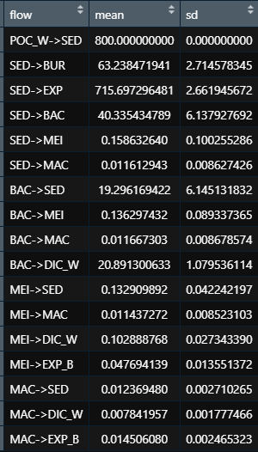
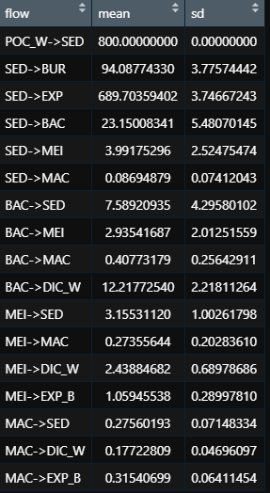
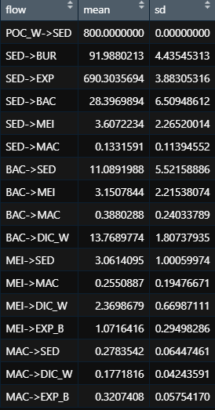
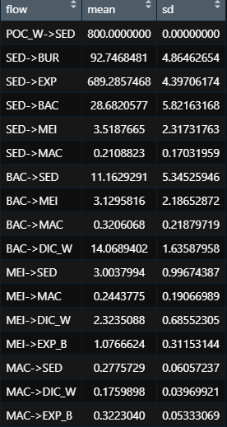
GC1_25000
GS1_25000_100
GS1_25000_50
GS1_25000_25
Mean coverage 90.72
Mean coverage 87.48
Mean coverage 89.58
Mean coverage 91.06

Slide 27
20221003 meeting
POC flux: 沒有滿杯的range
GC1: 200-800 g/m2/d
GS1 上限: GC1的下限/上限
GS1 下限: NSCS的trap + 衛星
Trap data on other slopes?
BR: 分母按照POC flux改
ER: 不更改
衛星資料: OSU NPP products
20221007 add
Bulk density

Slide 28
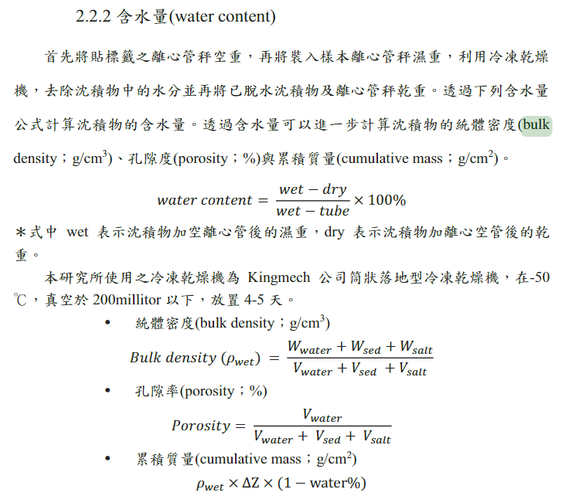
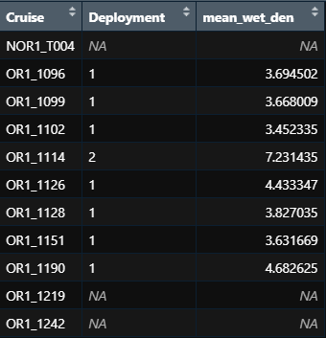
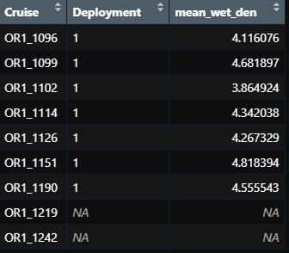
臺灣西南海域現代沈積物之傳輸途徑與機制
每站沉積物的乾濕重->自己算density (Data: WC WW DW )
乾重(DW)/乾的沉積物密度=沉積物體積，濕重(WW)/總體積=密度
2.65g/cm3
GC1
GS1
GC1: 120.41°E, 22.41°N
-> 2.1 (g/cm3)
GS1: 120.40°E, 22.23°N
-> 1.8 (g/cm3)

Slide 29




Slide 30

NPP data is from OSU’s Ocean Productivity Web site. The mean (mean, mgC/m2/d), standard deviation (sd), and coefficient of variation (svi) were calculated for NPP and CHL from all 464 months of data. z_eu and z are euphotic depth and water depth. lutz_poc is export POC flux (mgC/m2/d) to seafloor using algorithm from Lutz et al. (2007) with vgpm_mean, vgpm_svi, z_eu, and z.
wrong
vgpm_mean | vgpm_sd | vgpm_svi | chl_mean | chl_sd | chl_svi | z_eu | z | lutz_poc
846.9637 | 337.5780 | 0.3985743 | 0.7197180 | 0.5745413 | 0.7982866 | 41.80896 | 9.642858 | 30.82695
467.1410 | 151.6326 | 0.3245970 | 0.2653975 | 0.1672077 | 0.6300275 | 57.36357 | 221.625000 | 13.15140
vgpm_mean | vgpm_sd | vgpm_svi | chl_mean | chl_sd | chl_svi | z_eu | z | lutz_poc
846.9637 | 337.5780 | 0.3985743 | 0.7197180 | 0.5745413 | 0.7982866 | 41.80896 | 292 | 30.82695
467.1410 | 151.6326 | 0.3245970 | 0.2653975 | 0.1672077 | 0.6300275 | 57.36357 | 272 | 13.15140
衛星資料: OSU NPP products

Slide 31

Other POC data
太遠了
不確定是哪篇?

Slide 32


Li et al (2018) Elevated particulate organic carbon export flux induced by internal waves in the oligotrophic northern South China Sea
沒給座標
Min: 42.0 mg C m⁻² d⁻¹
Max: 73.0 mg C m⁻² d⁻¹

Slide 33




Shih et al (2020)
Station H: 22.0◦N 120.3◦E, ∼1000 m (2-year time series: 09 2012- 06 2014)
Station H

Slide 34

Shih et al (2020) (continued from p31)
I-POC=Integrated (0–150 m) POC
POC fluxes at 150 m depth
(below the euphotic zone)
Average I-POC
After typhoons (4.8 g C m⁻²) and storms (3.4 g C m⁻²)
Background I-POC in the wet season (5.5 g C m⁻²) and dry season (4.1 g C m⁻²)
Particulate organic carbon export fluxes
Shortly after typhoons: averaged 97 (78–115) mg C m⁻² d⁻¹
Associated with storms: averaged 80 (54–95) mg C m⁻² d⁻¹
Wet season: averaged 58 (42–73) mg C m⁻² d⁻¹
Dry season: : averaged 59 (44–74) mg C m⁻² d⁻¹
Dashed lines: represent average values in the wet (orange) and dry (purple) seasons.
Min: 42.0 mg C m⁻² d⁻¹
Max: 115.0 mg C m⁻² d⁻¹

Slide 35


Hung and Gong (2010)
Samples: 120°34’ E, 22°20’ N on 3-4 December 2008
Station
In the northern SCS elevated bulk POC fluxes of 63 ± 7, 50 ± 7 and 48 ± 6 mg C m⁻² d⁻¹ were found at 120 m, 150 m and 200 m, respectively
Trapping efficiency: 80% (Hung and Gong, 2007) and 75% (Li, 2009)
Based on the same traps deployed in the ECS and the oligotrophic waters of the northwest Pacific Ocean
Based on the 234Th/238U disequilibrium model of Buesseler et al. (1992)
59.45, 63.4

Slide 36


Shih et al (2019)
Sep. 5–7 (T1) (a week after a category 2 typhoon Tembin), Sep. 25–28 (T2), 2012 and Jul. 14–17 (T3)(~2 days after typhoon Soulik (category 2)) and Sep. 12–18 (T4, OR-V), 2013.
T1: 21.7°N 120.0°E, water depth ~2700 m
sediment trap: 150, 500 and 1000 m
T2: 21.6°N 119.9°E, water depth ~3200 m
sediment trap: 150, 500, 1000 and 2000 m
T3: 20.3°N 120.3°E, water depth ~3900 m; St. T4: 18.0°N 116.0°E, water depth ~3800 m; trap: 150, 500, 1000, 2000 and 3000 m
T1: 23–32 mg C m⁻² d⁻¹
T2: 24–46 mg C m⁻² d⁻¹

Slide 37
BE data in GPSC (the second version)
1. calculate the burial rate
# In Huh et al. (2009)
GC1_br<- 0.3 (g/cm2/yr)
GS1_br<- 0.7 (g/cm2/yr)
#br(g/cm2/yr)*1000/0.01/0.01/365*TOC(%)/100=(mgC/m2/d)
GC1_TOC<-0.39
GS1_TOC<-0.53
GC1_br<-0.3*1000/0.01/0.01/365*GC1_TOC/100 #=32.08(mgC/m2/d)
GS1_br<-0.7*1000/0.01/0.01/365*GS1_TOC/100 #=100.92(mgC/m2/d)
#2. POC flux
#in Liu et al. (2006): 200- 700 g/ m2/ d
#in Liu et al. (2009): 200- 800 g/ m2/ d
#TOC content (0.4-0.6 %)
GC1_POCmin<-200*1000*0.4/100 #mg C/ m2/ d
GC1_POCmax<-800*1000*0.6/100
GS1_POCmin<-115 #Shih et al. 2020
GS1_POCmax<-200*1000*0.4/100 #=GC1 min
#3. min burial efficiency=
burial rate (mgC/m2/d) / poc flux (mgC/m2/d)
GC1_br2/GC1_POCmin #=0.2029224
GC1_br2/GC1_POCmax #=0.0338204
GS1_br/GS1_POCmin #=0.8774855
GS1_br/GS1_POCmax #=0.1261385
Our data
#In Hsu et al. (2014)
#GS1_br<-0.31(g/cm2/yr)< 0.7 #(g/cm2/yr)
#In Tsai and Chung(1989)
#GC1_br<-0.723(cm/yr)
#br(cm/yr)*density(g/cm3)*1000/0.01/0.01/365*TOC(%)/100=(mgC/m2/d)
GC1density <-2.1
GC1_br2<-0.723*2.1*1000/0.01/0.01/365*GC1_TOC/100 #=162.34
#GC1_br2 > GC1_br -> use this data
Su et al. (2018)
GC1_POC_r1.input
GS1_POC_r1.input

Slide 38


!burial rate efficiency
minBR = 0.0338204 {fraction}
maxBR = 0.2029224 {fraction}
!export rate
minER = 0.0 {fraction}
maxER = 0.87 {fraction}
!POCflux
minPOC =800 {mgC/m2/d}
maxPOC =4800 {mgC/m2/d}
0.16
0.16
0.83
0.83
!-- SED
POC_W->SED= [minPOC,maxPOC] !POC flux
!-- SED
SED->BUR = [minBR,maxBR] * POC_W->SED !Burial
SED->EXP = [minER,maxER] * POC_W->SED !Export
GC1_10000
GC1_25000
Mean coverage 85.48
Mean coverage 93.99

Slide 39



0.46
0.63
0.50
0.51
0.33
0.47
!burial rate efficiency
minBR = 0.1261385 {fraction}
maxBR = 0.8774855 {fraction}
!export rate
minER = 0.0 {fraction}
maxER = 0.87 {fraction}
!POCflux
minPOC =115 {mgC/m2/d}
maxPOC =800 {mgC/m2/d}
GS1_10000
GS1_25000
GS1_25000_25
Mean coverage 88.48
Mean coverage 92.30
Mean coverage 96.66

Slide 40


GC1_25000_100
GS1_25000_25

Slide 41
BE data in GPSC (the third version)
A single value of POC flux
1. calculate the burial rate
# In Huh et al. (2009)
GC1_br<- 0.3 (g/cm2/yr)
GS1_br<- 0.7 (g/cm2/yr)
#br(g/cm2/yr)*1000/0.01/0.01/365*TOC(%)/100=(mgC/m2/d)
GC1_TOC<-0.39
GS1_TOC<-0.53
GC1_br<-0.3*1000/0.01/0.01/365*GC1_TOC/100 #=32.08(mgC/m2/d)
GS1_br<-0.7*1000/0.01/0.01/365*GS1_TOC/100 #=100.92(mgC/m2/d)
#2. POC flux
#in Liu et al. (2006): 200- 700 g/ m2/ d
#in Liu et al. (2009): 200- 800 g/ m2/ d
#TOC content (0.4-0.6 %)
GC1_POCmin<-200*1000*0.4/100 #mg C/ m2/ d
GS1_POCmin<-115 #mg C/ m2/ d #Shih et al. 2020
#3. min burial efficiency=
burial rate (mgC/m2/d) / poc flux (mgC/m2/d)
GC1_br2/GC1_POCmin #=0.2029224
GC1_br2/GC1_POCmax #=0.0338204
GS1_br/GS1_POCmin #=0.8774855
GS1_br/GS1_POCmax #=0.1261385
Our data
#In Hsu et al. (2014)
#GS1_br<-0.31(g/cm2/yr)< 0.7 #(g/cm2/yr)
#In Tsai and Chung(1989)
#GC1_br<-0.723(cm/yr)
#br(cm/yr)*density(g/cm3)*1000/0.01/0.01/365*TOC(%)/100=(mgC/m2/d)
GC1density <-2.1
GC1_br2<-0.723*2.1*1000/0.01/0.01/365*GC1_TOC/100 #=162.34
#GC1_br2 > GC1_br -> use this data
Su et al. (2018)
GC1_POC_r2.input
GS1_POC_r2.input

Slide 42


用GC1最小POCflux當GS1最大值合理嗎?
Or
用trap資料/trap efficiency當GS1的最大值
Fix burial efficiency
Export rate 0-0.87
GC1 上限改成去掉outlier(事件)的值
Fix burial efficiency
Export rate 0.82-0.87
GC1_10000
GS1_10000
Mean coverage 85.53
Mean coverage 80.97

Slide 43
Incubation (TOU&DOU) paper
Describe data
Relate to environmental data
Deep-learning -> SCOC layer

